Slide 1
NO BANK
Submitted by:-
Harsh (160080101036)
Kamal Singh (160080101040)

Slide 2
Introduction
No bank is an online banking system for transfer money through email id or account number. In this bank User can open account by filling all the details and after that user can easily transfer the money. User can also see the history of there previous transaction and user can also sell or buy the share of company.
In No bank we can also add modules for mobile recharge, DTH recharge, Broadband recharge and so on.

Slide 3
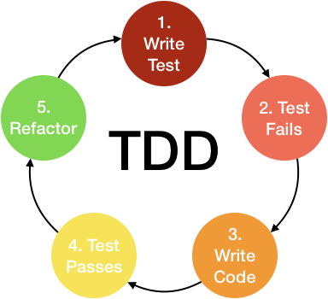
Methodology
Test-driven development (TDD) is a software development process that relies on the repetition of a very short development cycle: requirements are turned into very specific test cases, then the code is improved so that the tests pass. This is opposed to software development that allows code to be added that is not proven to meet requirements.

Slide 4
Modules
Login
Signup
Money Transfer (through email id or account number)
Buy and sell share of company

Slide 5
Framework Used
Spring Boot :- Spring Boot is a Spring module that provides the RAD (Rapid Application Development) feature to the Spring framework.
Spring Boot is a project that is built on the top of the Spring Framework. It provides an easier and faster way to set up, configure, and run both simple and web-based applications.
It creates stand-alone Spring applications that can be started using Java -jar.
It tests web applications easily with the help of different Embedded HTTP servers such as Tomcat, Jetty, etc. We don't need to deploy WAR files.
It provides opinionated 'starter' POMs to simplify our Maven configuration.
It provides production-ready features such as metrics, health checks, and externalized configuration.
There is no requirement for XML configuration.
It offers a CLI tool for developing and testing the Spring Boot application.
It offers the number of plug-ins.

Slide 6
Development Languages
JAVA
HTML
CSS
JavaScript

Slide 7
Tools and Libraries
Libraries:- spring-cloud
spring-security
eureka-discovery
cloud-config
cloud-server
zuul-proxy
thymeleaf
Hystrix
Tools:- Eclipse/IntelliJ idea, MongoDB, Git, BootStarp

Slide 8
Deployment
GitHub : It offers the distributed version control and source code management (SCM) functionality of Git, plus its own features. It provides access control and several collaboration features such as bug tracking, feature requests, task management, and wikis for every project.
Docker : Docker is a tool designed to make it easier to create, deploy, and run applications by using containers. Containers allow a developer to package up an application with all of the parts it needs, such as libraries and other dependencies, and deploy it as one package.
Heroku : Heroku is a cloud platform as a service supporting several programming languages. Heroku is used for hosting the website.

Slide 9
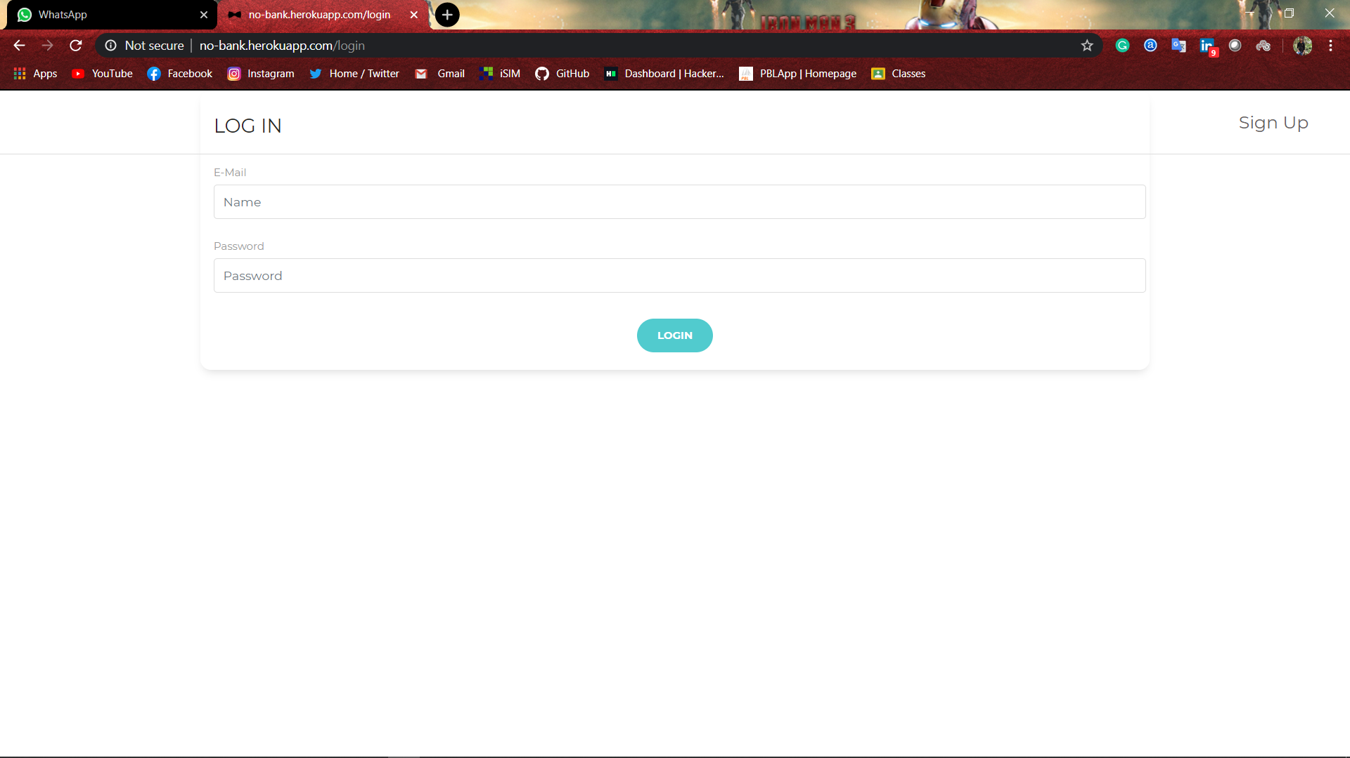
Screenshot

Slide 10
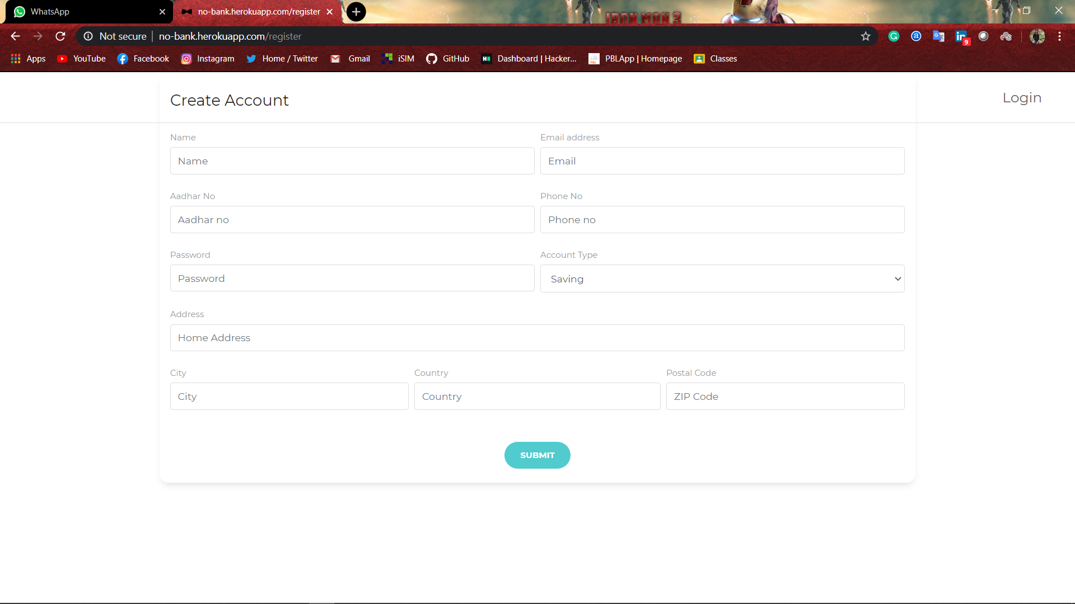

Slide 11
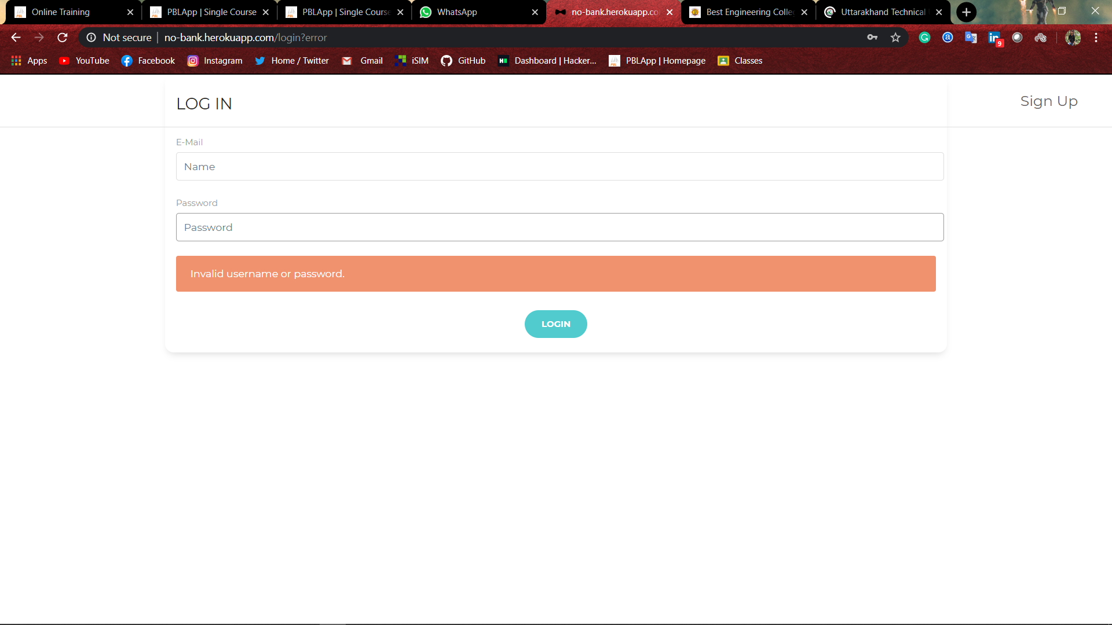

Slide 12
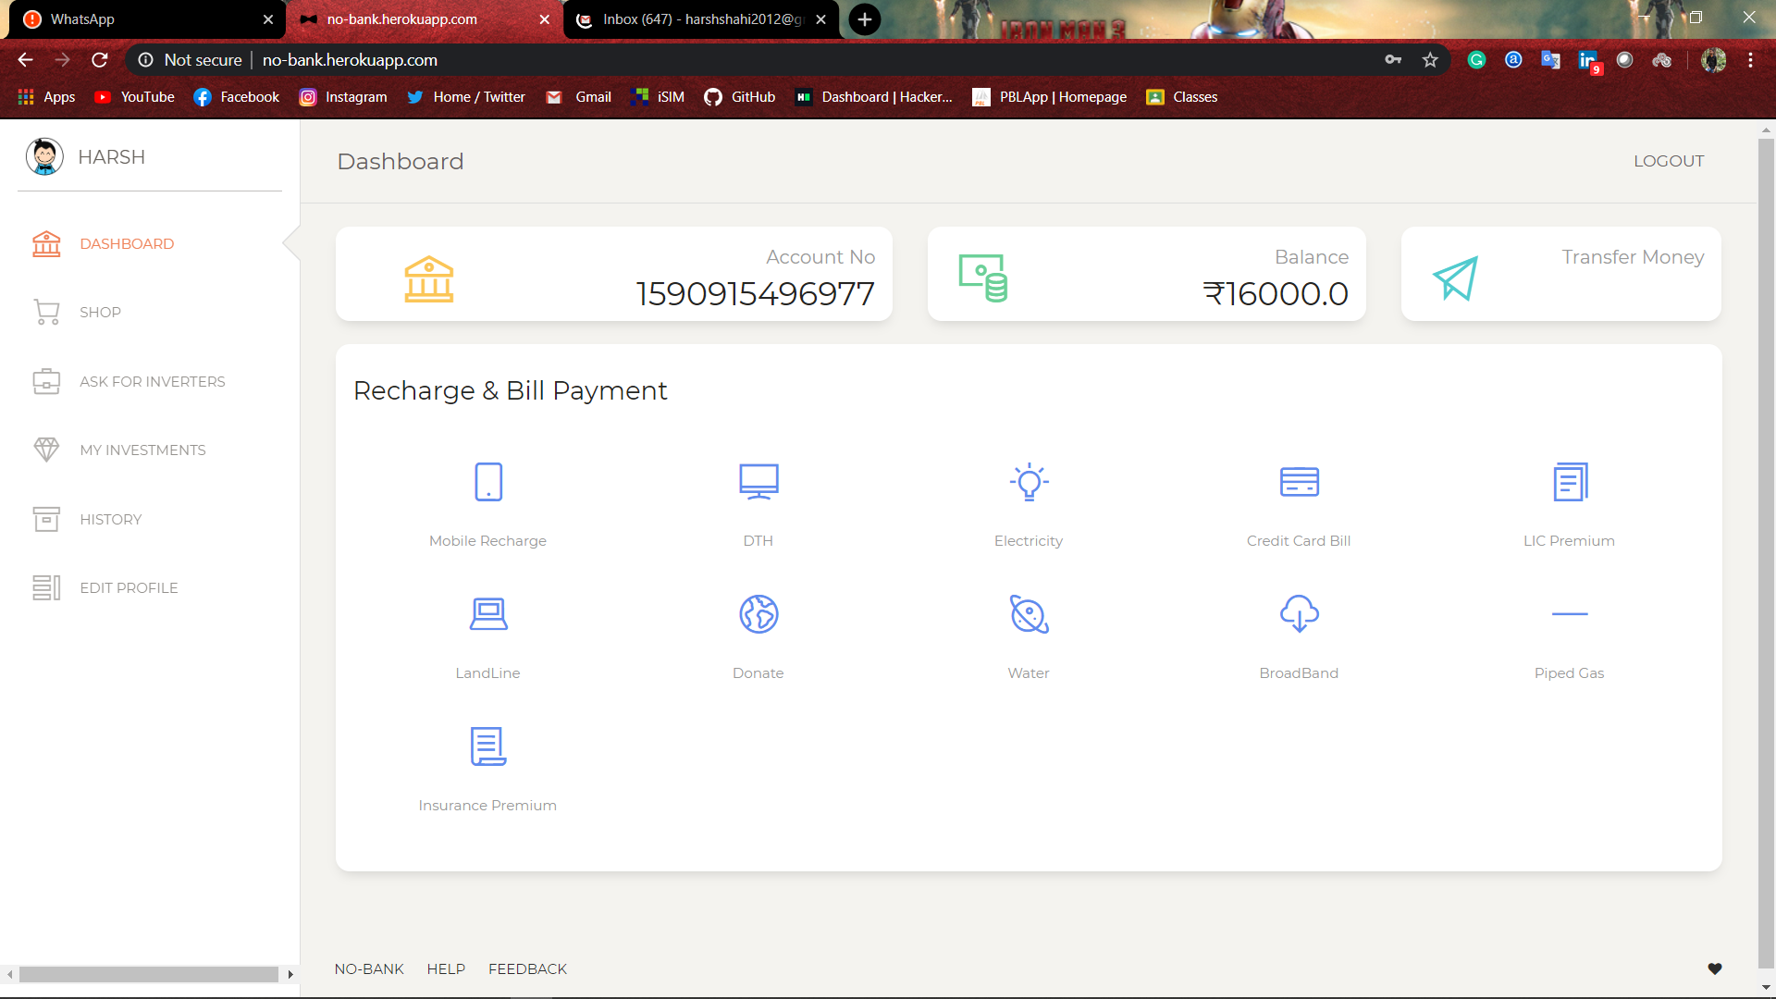

Slide 13
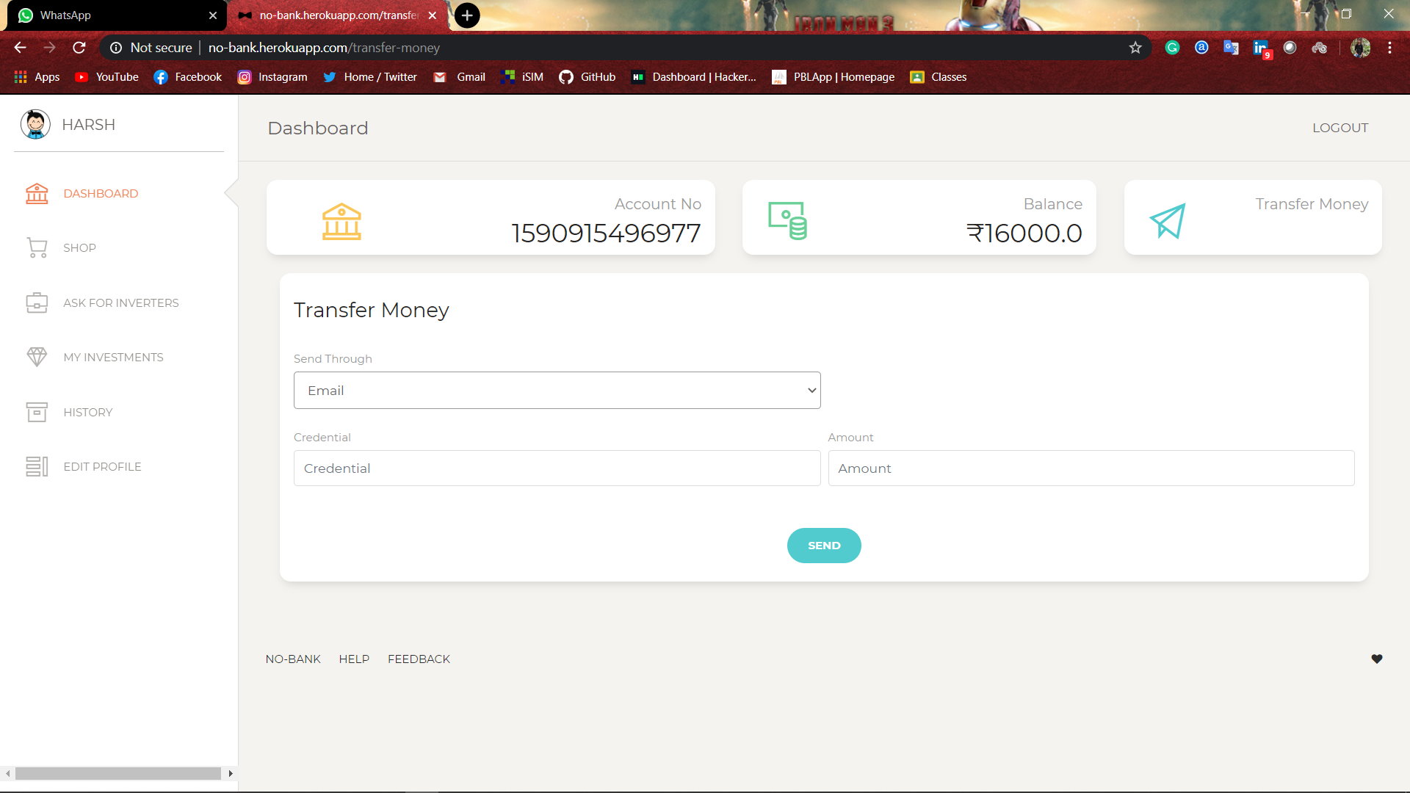

Slide 14


Slide 15
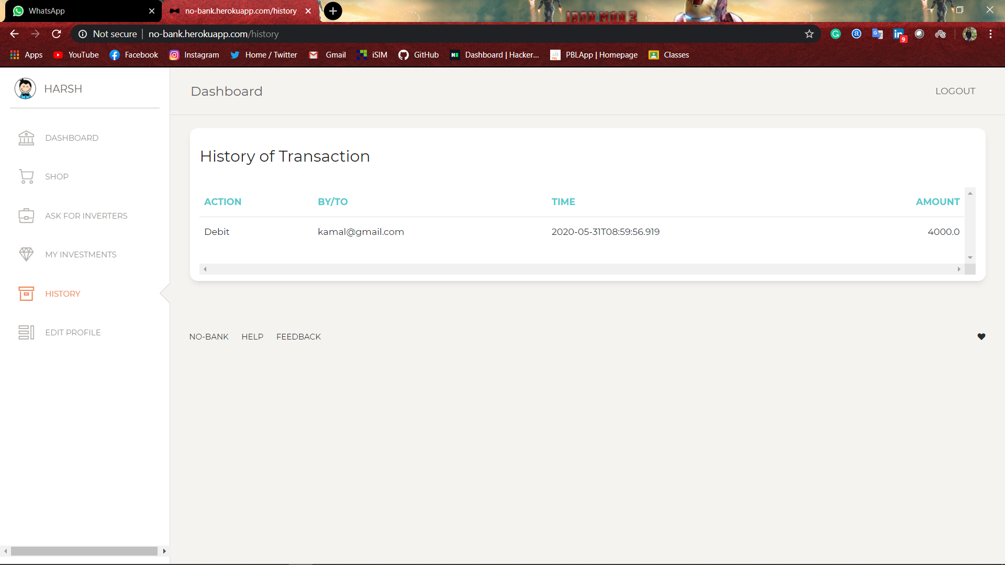

Slide 16
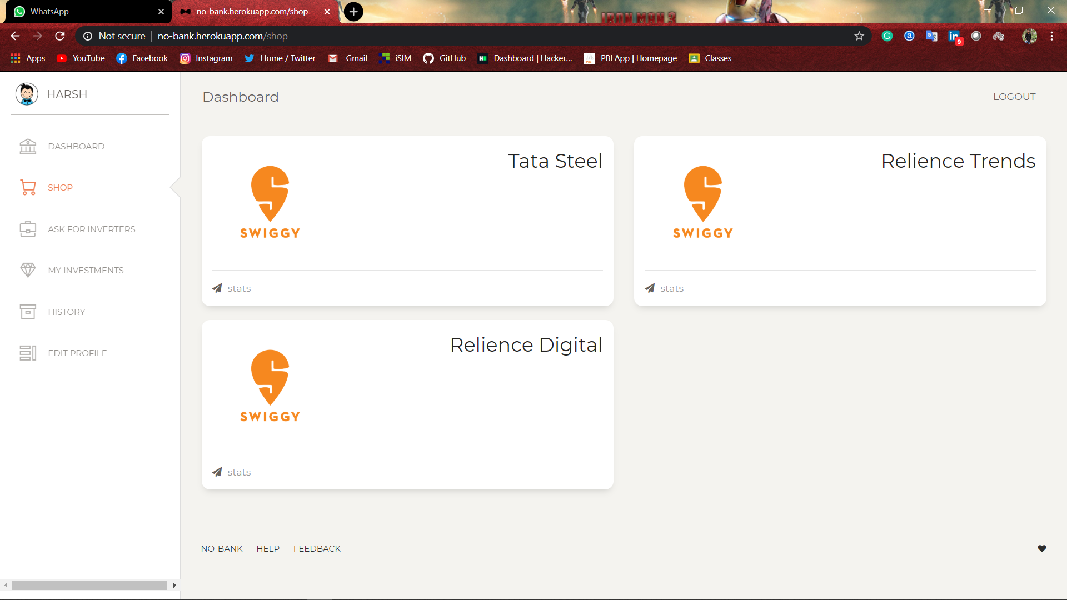

Slide 17
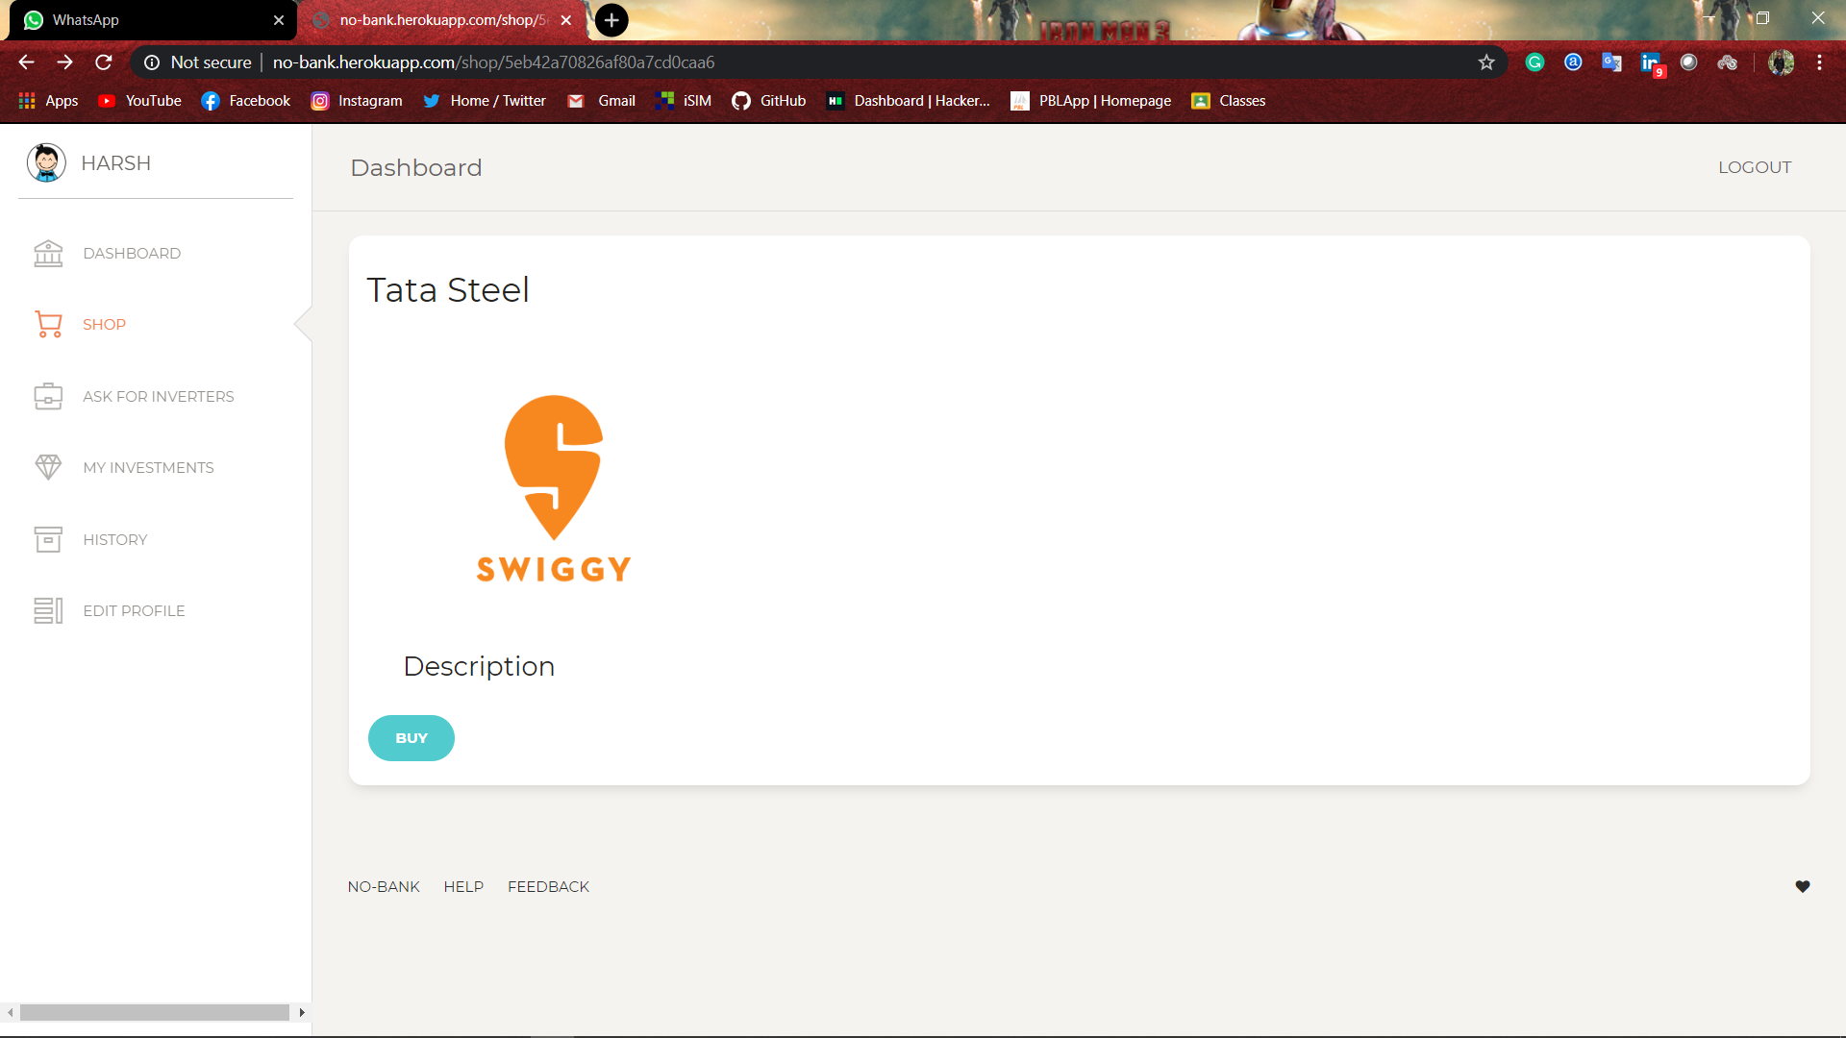

Slide 18
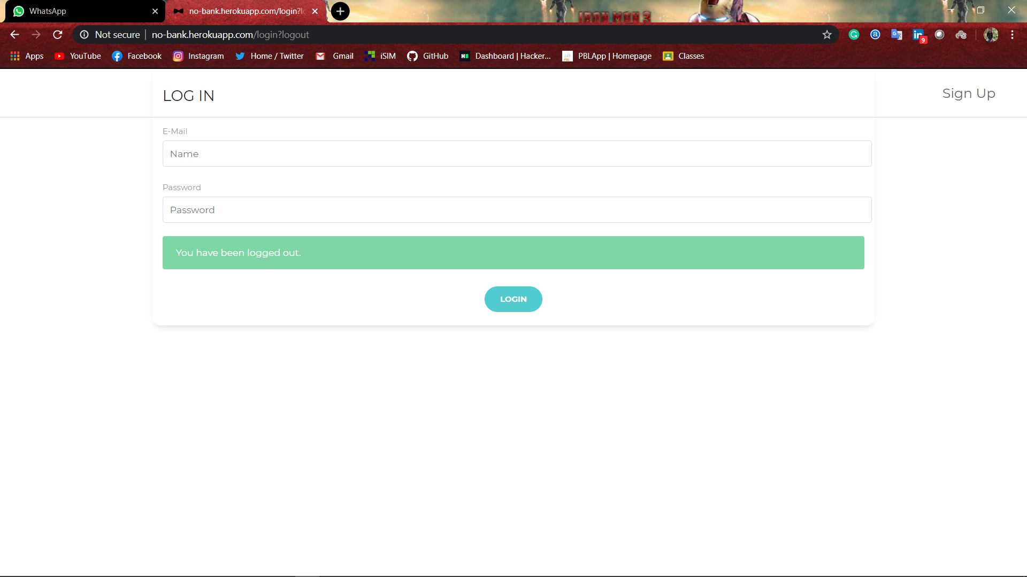

Slide 19
Thank you

